Slide 1

A Knowledge Graph for the Detection of Malware Behavior in Executables
Emily Miller
Advisor: Dr. Cogan Shimizu

Slide 2
Malware and Software Reverse Engineering
Definition: Analyzing an executable program to learn how it works [1]
Useful when source code is unavailable
Method to Combat Malware
Data Obfuscation makes this process difficult [2]

Slide 3

Ghidra
Tool used to conduct software reverse engineering [2][3]
Analyzes executables to get the disassembly and decompilation
Specially made to analyze malware [2]
Drawback: Produces a lot of data that is difficult to parse

Slide 4
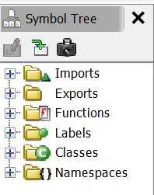
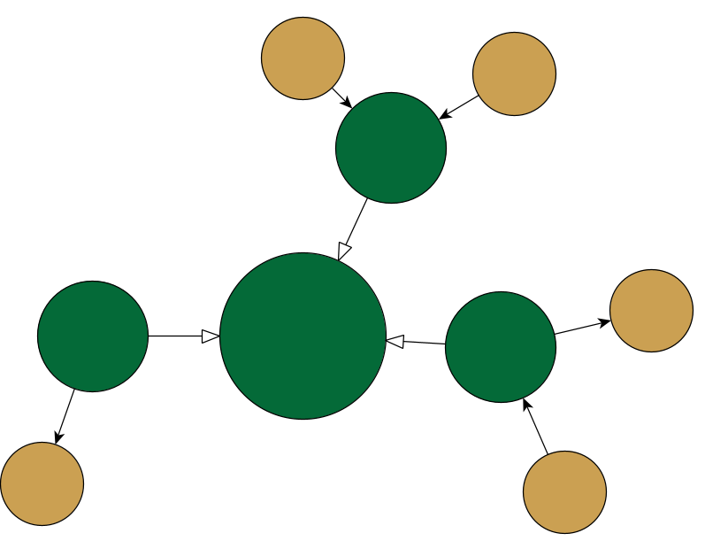
Data Organization
Research: organize the data from Ghidra analysis into a graph
Makes data more accessible and easier to parse [4]
Graph structured around symbol tree
Symbol: link between location and data [2]
Symbol Tree: hierarchical structure of symbols [2]

Slide 5
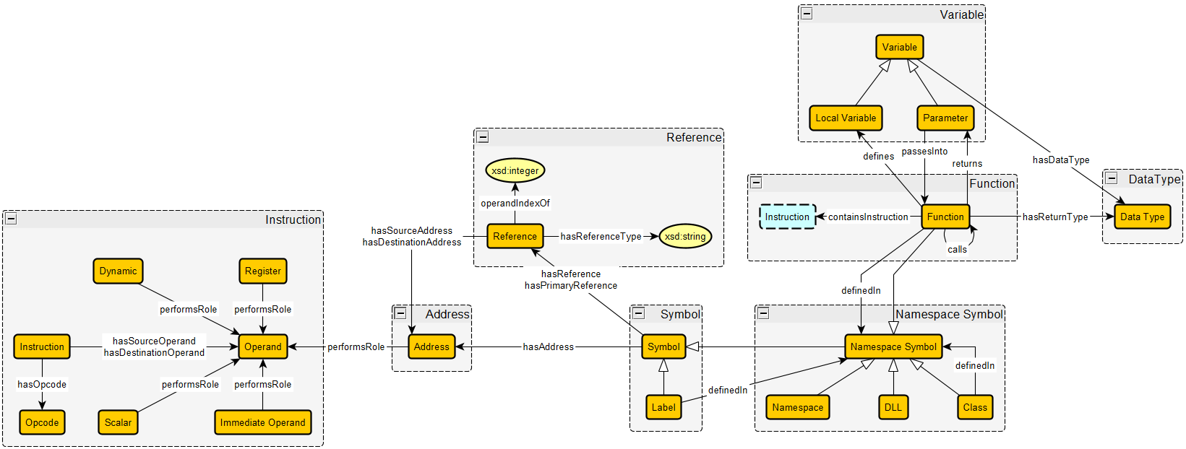
Schema Diagram of Knowledge Graph Made with yEd graph editor [5]

Slide 6
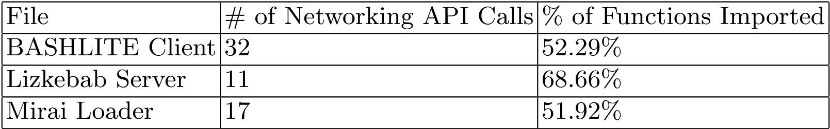
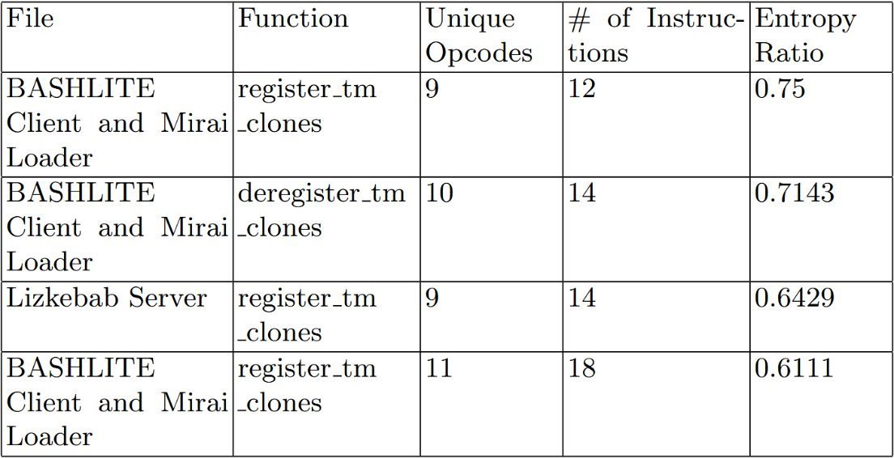
Results
Data: Malicious Unix-based executable files [6]
Patterns that indicate malicious behavior:
Noticeable differences in the number of networking API calls
High percentages of imported functions
High Entropy ratios in certain functions

Slide 7
Sources
[1] T. Cipresso and M. Stamp, “Software Reverse Engineering,” Handbook of Information and Communication Security, pp. 659–696, 2010, doi: https://doi.org/10.1007/978-3-642-04117-4_31.
[2] C. Eagle and K. Nance, The Ghidra Book: The Definitive Guide. San Francisco, CA, USA: No Starch Press, 2020.
[3] “Ghidra - Powerful Open-Source Reverse Engineering Tool,” Ghidra Lite, Aug. 20, 2024. https://ghidralite.com/
[4] kastle-lab, “GitHub - kastle-lab/kastle-drawbridge,” GitHub, 2025. https://github.com/kastle-lab/kastle-drawbridge (accessed Feb. 12, 2026).
[5] yWorks GmbH, yEd Graph Editor, version [Insert Version, e.g., 3.20]. [Online]. Available: https://www.yworks.com/products/yed.
[6] N. Partush, "Labeled-Elfs," GitHub, 2021. [Online]. Available: https://github.com/nimrodpar/Labeled-Elfs. [Accessed: 30-Mar-2026].

